Slide 1
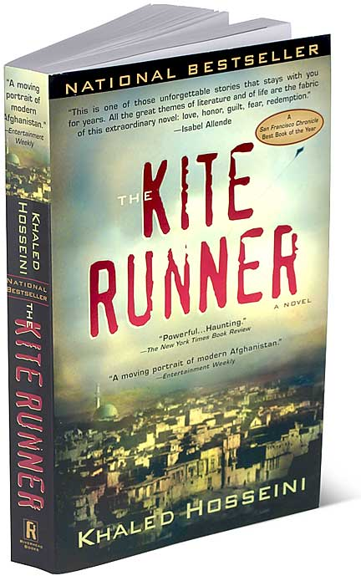
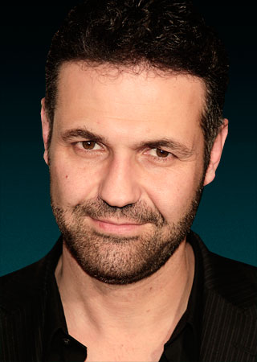
Kite Runner by Khaled HosseIni
The BEST book!
An informative presentation on the value of ‘The Kite Runner’ and why it would make an excellent addition to any school library
A picture of Khaled Hosseini
By Sabrina ‘The Teen Reviewer’
Issued by ‘Coffee Talk’ productions

Slide 2
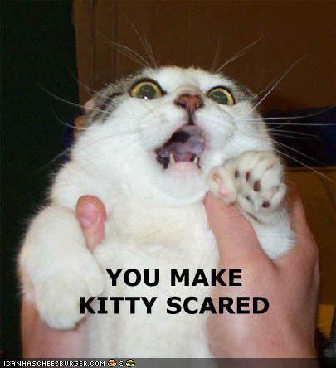


Don’t be INTIMIDATED!
This book is 400 pages long
A recent study shows that most students find larger and thick books scary and thus, do not try to read them
‘The Kite Runner’ may be long however the content and plot fills these pages and by the end of the novel, you will actually want more
Due to the descriptive language and high vocabulary, this book may seem challenging BUT for older readers, the book should make good sense.

Slide 3

A brief overview
The Kite Runner is about a boy named Amir who grew up in Kabul, Afghanistan in his journey of friendship and loyalty.
Amir and Hassan have been friends since they were born; speaking each other’s names as their first words however they have a forbidden friendship.
Both children were 12, still so young. Amir and Hassan were participating in the annual kite fighting contest. The duo was performing greatly and won the contest however when Hassan ran the last kite, an older boy named Assef assaulted him while Amir just watched. Since then, the two went their separate ways however Amir cannot stop thinking of his past
Throughout this novel, Amir learns how his decisions shaped the rest of his life. But is it too late to right the wrongs he made after all these years?
Told in Amir’s perspective, the Kite Runner, tells of the endless boundaries of friendship, even forbidden ones.
Has three parts and a linear plot sequence

Slide 4
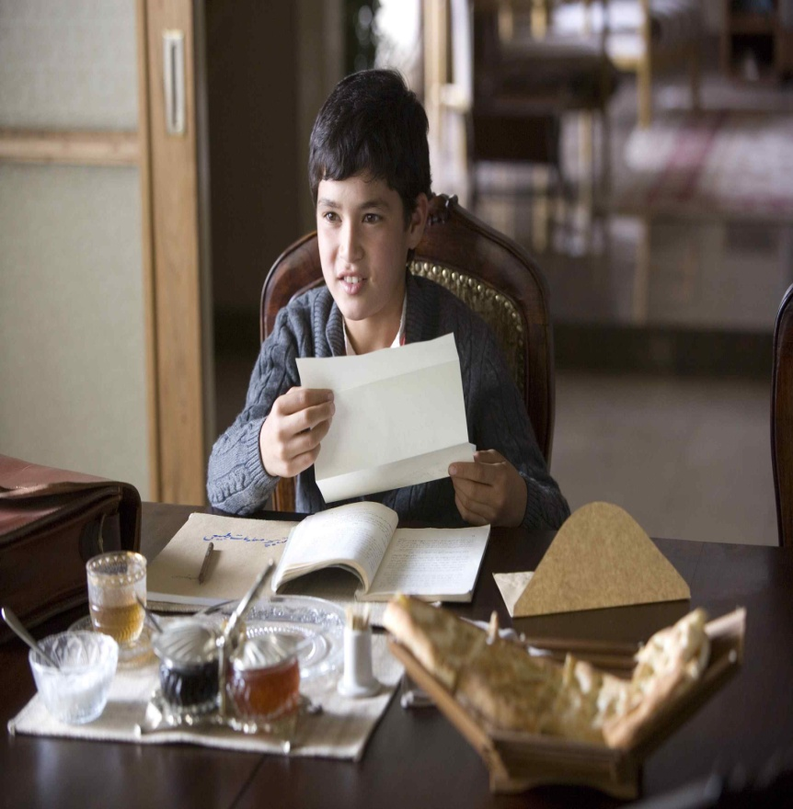
The STARS of the novel!
AMIR
He narrates the story and from birth, is a strange child.
He would rather read than play sports although he has excellent kite flying skills.
He loves to tell stories and since childhood, wanted to become a writer.
Amir was born in 1963 to his father, Baba while his mother died in giving birth.
He is rich.
Amir has shown to be a coward by not taking risks and letting others fight his battles.
He also starts the novel by being self-righteous (only believing he is right) and belittling his servants

Slide 5
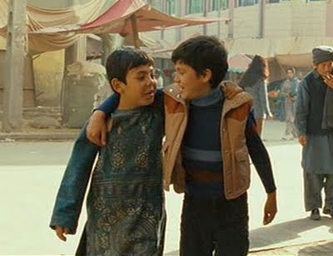
The STARS of the novel!
HASSAN
Amir’s best friend in childhood, his first word was ‘Amir’.
He is a Hazara, lower class, although he does not mind and enjoys his work as being Amir’s servant.
Hassan is illiterate but loves it when Amir reads him stories.
He is shown to be a modest, humble, honest and loyal individual.
He is a great friend to Amir although Amir treats him unkind. He is obedient and will do anything Amir asks of him. He retrieved Amir’s blue kite with the cost of his assault.
Hassan does not lie, believes it is a sin but lied for Amir. He always does not believe he is worthy of Amir.
Hassan has a sweet face, green eyes and a later fixed, harelip.

Slide 6
The STARS of the novel
Baba
Assef
Father to Amir
Treats his servants with respect
Is friends with head servant, Ali
Is not a good father, often neglects his child, makes him feel in superior
Favours Hassan over Amir
Hates to see people show emotion by crying
Is ashamed by his son
Does not ever give praise or respect to Amir
The antagonist of the novel
He is a bully and bullies Hazaras like Hassan
He assualted Hassan believing he was lower class
Idolizes Hitler and his vision
Wants to rid Afghanistan of Hazaras
Believes violence is the key
Is rude and inpolite
Intimidates his own friends
Has German mom and Afghan dad

Slide 7
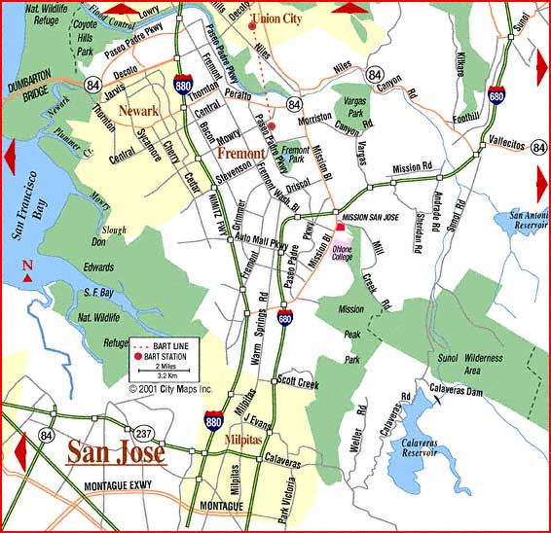
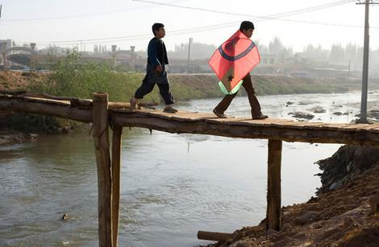
The FABULOUS Settings
Kabul, Afghanistan:
Amir lives in rich house with Baba – has mosaic tiles, marble floors etc.
Hassan lives in a small hut with Ali (father) – dimly lit, spare, clean and is a servant quarter
Frequently visit and read at the bowl-shaped hill underneath pomegranate tree – carved ‘Hassan & Amir, Sultans of Kabul
Winter is the favourite season: kite running tournaments take place
In winter of 1975, in a dark alley was place of assault
Fremont, California 1980s: Amir and Baba move to America, new climate, opportunities, larger and less friendly
Many adventures and truths come from both these settings and somehow, Amir always finds himself back in Kabul

Slide 8
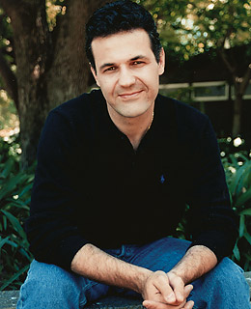
The Author: Khaled Hosseini
Was born in Kabul, Afghanistan in 1965
Father was a diplomat and his mother taught Farsi and History
In 1976, family was relocated to Paris and then later the United States
Graduated from high school in 1984
Finished Santa Clara university in 1988 with a bachelor degree in biology
In 1993, he earned a Medical degree
His debut novel, ‘The Kite Runner’, got published in 2003 in 48 different countries, becoming a BEST SELLER
His second novel, ‘A Thousand Splendid Suns’ published in 2007 in 40 countries
He currently provides humanitarian assistance in Afghanistan
Source: http://www.khaledhosseini.com/hosseini-bio.html

Slide 9
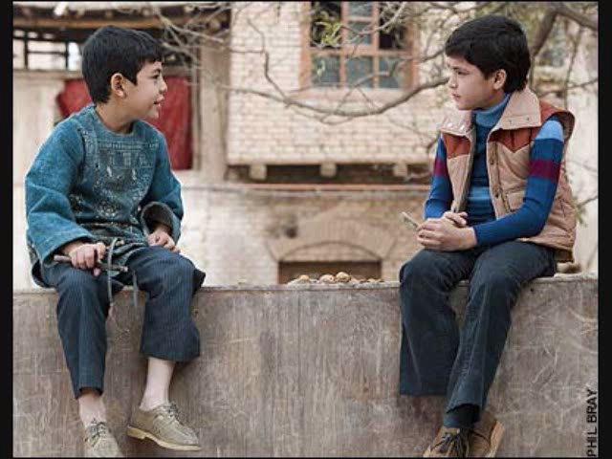
Book TRAILER
In order to help our visual learners in the audience, I have created a non-official trailer for ‘Kite Runner’. Enjoy.

Slide 10
Why else should YOU read this book?
A fantastic moral
Great imagery, descriptive language and suspense
There is an adaption
You can share your opinion with others
The critics and regular people loved it

Slide 11
Read a great novel. Learn a great lesson
It teaches us that we can’t wait forever to make choices because it may be too late and also that are choices we make now can have an effect on our future.
Amir waits too long to make decisions and then the moment is over. He is a coward. He does not act on his thoughts. Amir wanted to help Hassan but he didn’t. This scarred his life and ruined a great friendship.
Our choices we make now shape or future. Because Amir framed Hassan he lost his friend but Hassan met his wife and bore a child. By changing that one action when he was 12, both lives would be changed.
What is worse: doing something and wishing you hadn’t or doing nothing and wishing you had?
Teaches you about persistence and even when all odds are against you, not giving up
Generosity from the kindness of one’s heart. Not expecting a reward in return. Like how Hassan gives Amir anything he wishes without expecting so much as a thank you

Slide 12
THE MAIN MESSAGE:
‘Kite Runner’ is all about Loyalty
Betrayal, and being a
GREAT FRIEND!

Slide 13
‘The Kite Runner’ seems SO real!
Khaled Hosseini succeeds in writing imagery through his descriptive words
Readers will love the true-to-life settings: they make you feel like you are actually breathing in the air and living their
Hosseini gives readers the opportunity to see their world in a whole new perspective, 12-year-old Amir from Afghanistan
Characters, Amir and Hassan seem shockingly real and relatable
Perfectly captures the friendship relationship because in reality, it is not perfect. There are fights, arguments and teasing.
Have the same issues as regular teens (i.e. bullying, school work) but with some twists
Written in first perspective to allow reader to be able to hear and experience Amir’s life and thoughts while also seeing themselves in his characters
Amir is NOT a Mary Sue character, but instead is so real he might as well be alive.

Slide 14
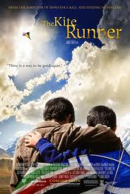
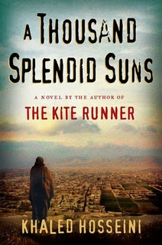
Adaption and Further Novels
This book has been made into a film of the same name. Students who show interest in this book, and who wouldn’t, will enjoy seeing their beloved book being turned into a movie. Watch the characters come to life and see the story play out.
Teachers, the movie provides you with the opportunity for the students to identify the differences between the movie and the book. It also allows the students to work on a fantastic novel study. After reading the book as either a class or individual, they can then identify character development, summary and main idea while also making connections. To finish the project, a movie will surely interest students.
Khalid Hosseni has written a second novel also placed in Kabul with a similar theme of forgiveness. This book is called ‘A Thousand Splendid Suns’ and readers who enjoy Kite Runner will certainly enjoy the above novel.

Slide 15
You can discuss ‘Kite Runner’ with others!
Ask parents before visiting any website
Coffee Talk is originally a talk show starring host, Sabrina Macklai. Content includes celebrity gossip, randomness and more.
Just go to this website www.coffeetalkonline.weebly.com
Click on the ‘Books’ tab
You will find a book blog on Kite Runner
Scroll down to add a comment on your thoughts, ideas, dislikes etc. about the book
Have fun!

Slide 16


Critics LOVED ‘Kite Runner’
A powerful first novel … In ''The Kite Runner,'' Khaled Hosseini gives us a vivid and engaging story that reminds us how long his people have been struggling to triumph over the forces of violence -- forces that continue to threaten them even today. ~ New York Times Reviews
“The Kite Runner is a shattering first novel … Hosseini is certainly the first Afghan novelist to fictionalize his culture for a Western readers … The Kite Runner is about the price of peace, both personal and political, and what we knowingly destroy in our hope of achieving that, be it friends, democracy or ourselves. ~ The Observer
“Hosseini does tenderness and terror, California dream and Kabul nightmare with equal aplomb … A carefully built structure of ripping yarn and ethical parable … Hosseini deftly manages his intimate narrative of love, betrayal and reconciliation” ~ The Globe and Mail

Slide 17
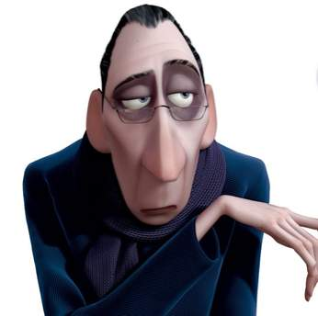
More Reviews from Critics
“Stunning … an incisive, perceptive examination of recent Afghan history … It is rare that a book is at once so timely and of such high literary quality.” ~ Publisher Weekly
“A powerful book … Parts of ‘The Kite Runner’ are raw and excruciating to read, yet the book in its entirety is lovingly written.” ~ Washington Post
“A stunning first novel which puts a human face to the recent events in Afghanistan … A moving portrait of friendship, loyalties, the difficult relationships between fathers and sons, and of the clash of culture” ~ The Toronto Sun
“Like ‘Gone With the Wind’, this extraordinary first novel locates the personal struggles of everyday people in the terrible sweep of history.” ~ People
“A striking debut from an Afghan now living in the US. His passionate story of betrayal and redemption is framed by Afghanistan’s tragic recent past… Rather than settle for a coming of age or travails of immigrants story, Hosseini has folded them both into this searing spectacle of hard-won personal salvation … Irresistible.” ~ Kirkus Reviews

Slide 18

And look at all these AWARDS
Borders Original Voices Award
Entertainment Weekly's Best Book
San Francisco Chronicle Best Book of the Year
Literature to Life Award
ALA Notable Book
Alex Award
Book Sense Bestseller
List Sensation
Boeke Prize
Barnes and Noble
Discover Great New Writers Award

Slide 19

Even cool CELEBS read this novel!
Popular celeb Deepika Padukone said, “I read "The Kite Runner" by Khaled Hosseini and I really liked it. It's a wonderful book."
FAMOUS people read this book

Slide 20
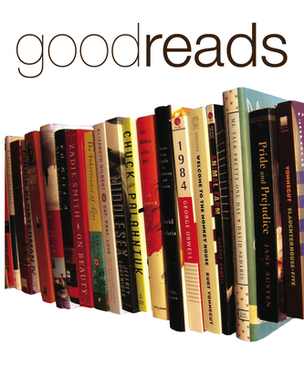
REAL People Like You!
It got 4.7/5 stars based on 176 CONSUMER reviews!
These quotes below are made by REAL life people, not just paid consumers. Quotes are from book sharing site, Good reads
This is a emotionally difficult read but a beautifully told story about love and betrayal and loss. ~ Lisa Vegan
Kite Runner, I started over a long weekend and could not for the life of me put it down. ~ Linda
Overall, the book has all of the ingredients needed to create a great tale - whether or not it required some belief-suspension and some editorial errors. ~ Mystique O’Purr
Speechless when I'm finished this book... ~ Roos
Their story touches on the complexities of familial love and accurately shows that, at times, we can love and hate those we feel the closest too.
Highly recommend this one! ~ Zeek

Slide 21

In conclusion, BUY THIS BOOK!!!!
You just have to buy this book! Kite Runner is a fantastic read and will certainly NOT disappoint. The author creates such perfect imagery and includes plenty of descriptive language that it is IMPOSSIBLE to put down. But buy it now because with the sales of this book, it might be gone tomorrow! Remember, The Kite Runner!

